Slide 1
Metadata:
Exposed and Expunged
Charity Anastasio
Director, Law Office Management Assistance
Maryland State Bar Association
January 24, 2017
Colorado Bar Association

Slide 2
We will cover
What it is
Where to find it
Examples and ethics
How to remove harmful metadata

Slide 3

What Is Metadata?
“Data about data”
Application
Document
Email
Embedded
File system
Notes:
Application – field codes for how the computer/printer will display, color, font, spacing, styles, etc. Embedded in file. Some travels with copy and paste.
Document – document properties such as editors, edit time, size of file, pages, etc. Usually information in properties.
Email – recipients (direct, cc, bcc), sender, received date, folder structure, email addresses
Embedded – notes, comments, track changes, formulas in Excel, hyperlinks. Can be hidden or revealed.
File system – creation date, modified dates, last accessed date, file path. Some of this is in properties also, but this is external to the document, on the device usually.

Slide 4
What does it say?
Item | Program Examples | Dangerous Parts
Document | Microsoft Word, Word Perfect, Google Docs | Where, when, who edited and how much; Track changes , notes and comments give strategy, thought processes, dead ends, undisclosed positions, etc.
Video/Picture | Any digital photo or video | Type of camera, geographic location taken, time and date stamp, lighting, etc.
Slides | PowerPoint, Google Slides, Keynote | Where, when, who edited and how much; Track changes , notes and comments give strategy, undisclosed positions or business projections, etc.
PDF | Adobe Acrobat, Nuance PDF | Can track changes here also, editors, opinions, ideas, changes.
Spreadsheet | Excel, Google Sheets | Embedded contracts, formulas, notes, comments. Editors, etc.

Slide 5

Metadata lessons: Microsoft Word
2003 British Intelligence Dossier fiasco
2004 SCO Group UNIX & Linux lawsuit blunder
2005 UN assassination report reveals suspects unintentionally
Notes:
2000 U. S. Senate candidate emails expose poor behavior
2015 Microsoft Word document shows Conservative party was author of what was supposed to be unbiased report

Slide 6
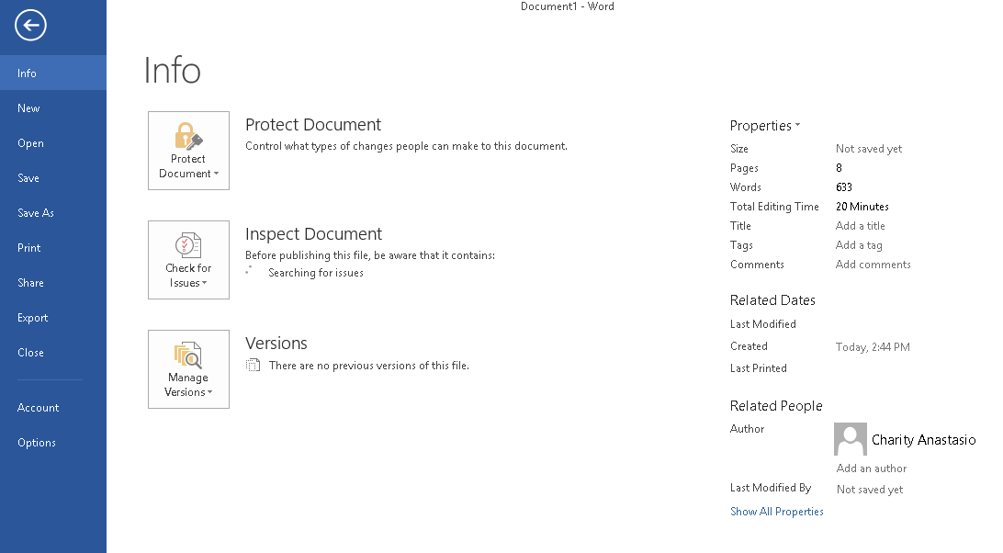
Microsoft Word

Slide 7



Slide 8

Metadata lessons: PDF Redaction
2008 General Electric’s counsel fails to properly redact on response
2009 discovered HSBC bankruptcies
2013 Global Bank reveals 150k customer bankruptcies
2014 Australian federal police publish secret criminal investigation data online for years
US Public Domain tag.
Notes:
2008 General Electric’s counsel fails to properly redact 2007 sex discrimination case information before filing
2009 discovered HSBC didn’t properly redact Chpt 13 bankruptcy docs for 2 years
2013 Global Bank between 2007 – 2011 because it doesn’t properly redact SSNs, etc. in court filings

Slide 9
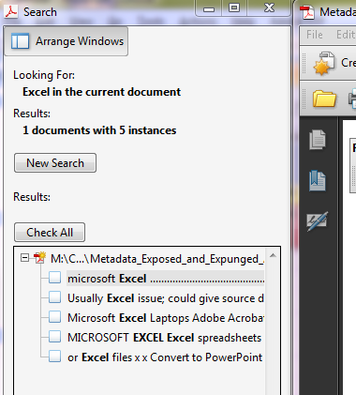
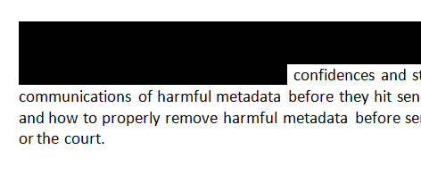
Redaction
WRONG
RIGHT

Slide 10
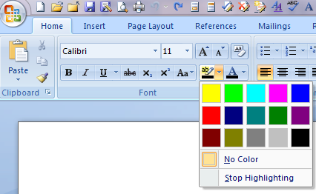
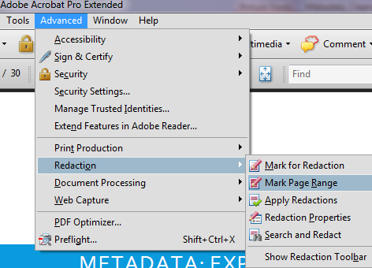
Redaction (cont.)
WRONG
RIGHT

Slide 11
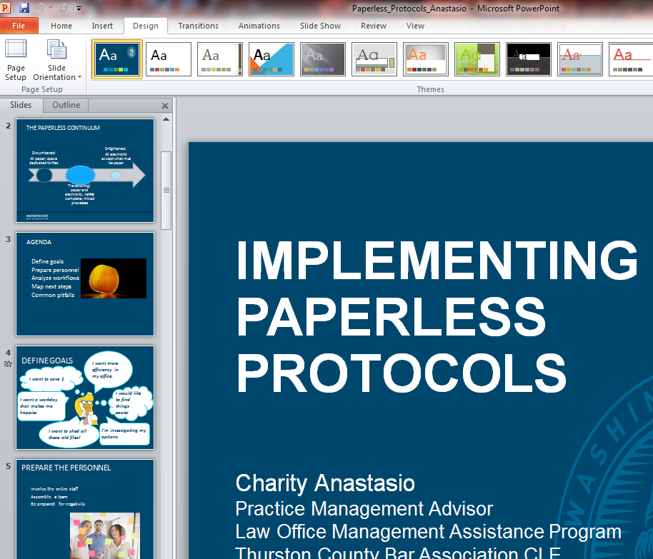
Metadata lessons: PowerPoint
2006 Google reveals financial projections/advertising revenues before intended
2014 New York Times exposes NSA agent and targeted network

Slide 12
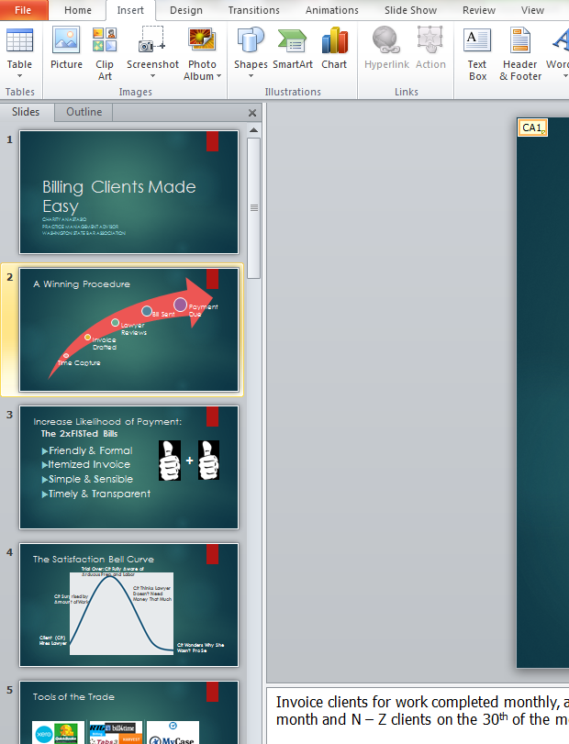


Slide 13
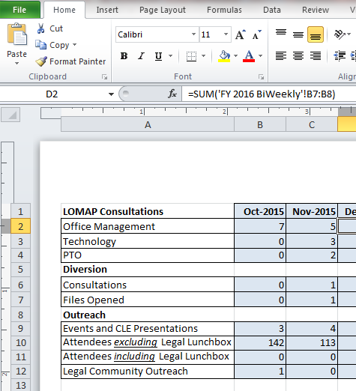
Metadata lessons: Excel
2008 Lehman Brothers bankruptcy purchase deal goes wrong for Barclays
2013 London Council pays £70,000 penalty for posting Excel spreadsheet with personal information online

Slide 14

Metadata lessons: Picture
2012 John McAfee “on the lam”
Notes:
2012 John McAfee captured because of metadata trail on digital photograph when he’s “on the lam”

Slide 15
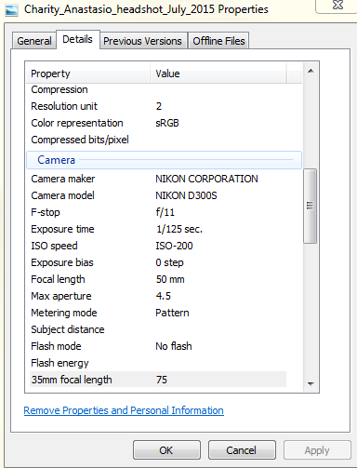
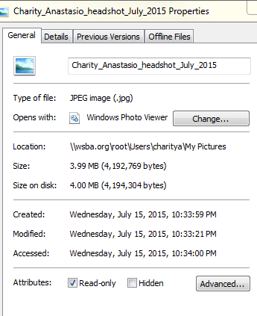
Digital pictures

Slide 16

Metadata lessons: Telecommunications
2016 Canadian’s telecommunications scandal
Notes:
2016 Canada’s spy agency gives Canadian’s telecommunications info internationally by not stripping metadata properly. Have no clue how much given.

Slide 17

What are the rules?
“Keep it secret! Keep it safe!”
  Colorado RPCs
    1.6(a) - confidentiality
    1.1- competence
    5.1- supervising lawyer responsibilities
    5.3- supervising non-lawyers
    4.4(b)-respect 3rd party rights
    8.4(d)- misconduct catch all
Notes:
Rule 1.6. Confidentiality of Information
A lawyer shall not reveal information relating to the representation of a client unless the client gives informed consent, the disclosure is impliedly authorized in order to carry out the representation, or the disclosure is permitted by paragraph (b).
Rule 1.1. Competence
A lawyer shall provide competent representation to a client. Competent representation requires the legal knowledge, skill, thoroughness and preparation reasonably necessary for the representation.
Rule 4.4. Respect for Rights of Third Persons
In representing a client, a lawyer shall not use means that have no substantial purpose other than to embarrass, delay, or burden a third person, or use methods of obtaining evidence that violate the legal rights of such a person.
Rule 8.4. Misconduct
It is professional misconduct for a lawyer to: (d) engage in conduct that is prejudicial to the administration of justice;
Also sited in other jurisdictions:
Rule 1.9. Duties to Former Clients
(c) A lawyer who has formerly represented a client in a matter or whose present or former firm has formerly represented a client in a matter shall not thereafter:
(2) reveal information relating to the representation except as these Rules would permit or require with respect to a client.
Rule 1.4. Communication
A lawyer shall: (2) reasonably consult with the client about the means by which the client’s objectives are to be accomplished;
Rule 3.4. Fairness to Opposing Party and Counsel
A lawyer shall not: (a) unlawfully obstruct another party’s access to evidence or unlawfully alter, destroy or conceal a document or other material having potential evidentiary value. A lawyer shall not counsel or assist another person to do any such act;

Slide 18
How does Colorado Compare?
Comparison of State Ethics Opinions
  Sender’s duty to cleanse? Reasonable Care
  Recipient permitted to review or “mine”? 7 Yes, 10 No, 2 it depends
  Must recipient notify sender if found? 14 Yes, 2 No, 3 not addressed
  Doesn’t apply to discovery All that address
ABA Formal Ethics Opinion 06-442 No (but discusses options), yes, yes
Colorado Ethics Opinion 119 Reasonable care, yes, yes
    Duty to notify sender if determined
    Duty to stop if notified pre-inspection

Slide 19
Expunging It?
Fax it
Scan it
Cut and paste
Convert to PDF
Microsoft inspection and removal tools
Adobe Acrobat Pro remove and sanitize tools
Metadata Scrubbers

Slide 20

Fax It
May appear to be technologically archaic
Security through obscurity
Only retains metadata of the faxing
Put document pages in fax
Send to fax machine phone number
Date stamped and not OCR

Slide 21

Scan it
Leaves only the metadata of the scan
Some can OCR, but not all
Labor intensive
Put document in scanner
Creates a PDF
Modern scanner scan OCR
Send PDF to file/transmitting location
Send in encrypted email or put on secure portal

Slide 22
Cut and paste into a new document
Cntl +A – Select all
Cntl +C – Copy
Open a new blank document
Cntl +V – Paste
Retains metadata of the new document
Formatting comes with
Track changes not yet dealt with will be accepted and included

Slide 23
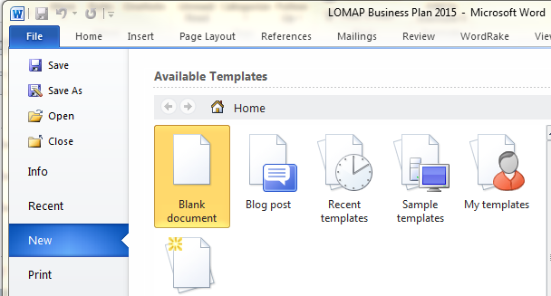
Cut and paste into a new document

Slide 24
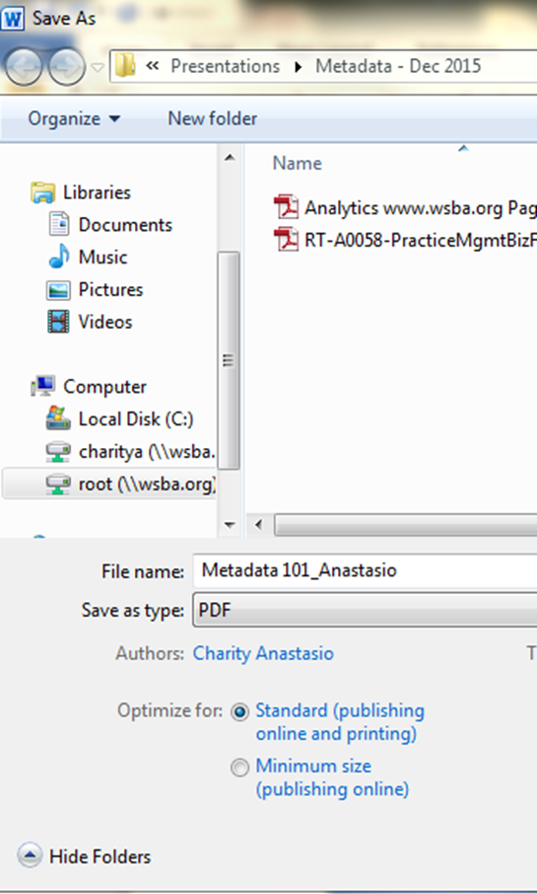
Convert Word Doc to PDF
Go to File
Select Save As
Pull drop down menu on Save as Type
Select PDF
Review document for damaging data
Some metadata comes along
Most damaging is stripped out
Ensure track changes off

Slide 25
Use Microsoft inspection and removal tools
Go to File
Check for Issues (Prepare for Sharing)
Inspect
Click Remove on all issues want to remove
Reinspect
Retains basic metadata of document

Slide 26
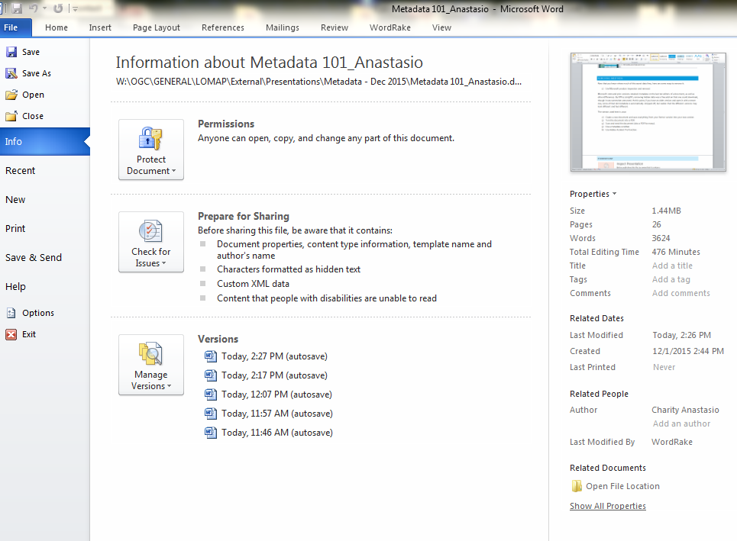
Use Microsoft inspection and removal tools

Slide 27
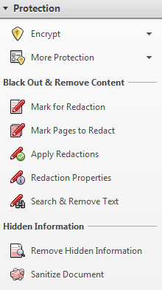
Adobe Acrobat Pro remove and sanitize tools
Go to Tools
Select Protection
Then select Hidden Information
Click on Remove Hidden Information
Click on Sanitize Document

Slide 28
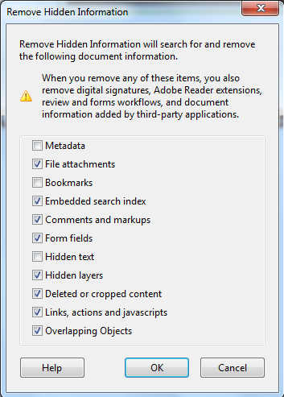
Adobe Acrobat Pro remove and sanitize tools

Slide 29
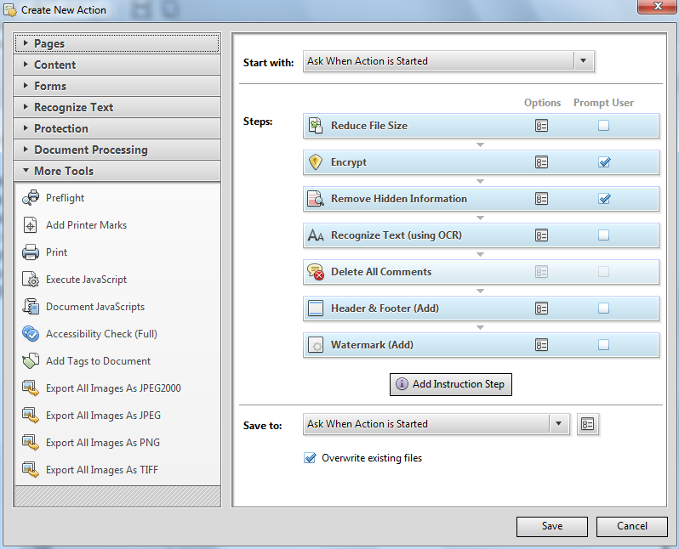
Adobe Acrobat Pro Action Wizard

Slide 30
Adobe Acrobat Pro Action Wizard
Set up Action Wizard to prepare every document for sharing the same way
Select Tools and Action Wizard
Click Create New Action
An example: When is action started/A file on my computer. Selected encryption, delete comments, remove hidden information (metadata), and reduce the file size. Add a Watermark because it is a draft and a header and footer to brand it to the firm’s look. Select recognize text using OCR.

Slide 31
Adobe Acrobat Pro Redaction
Go to Protection
Select Mark Pages to Redact to search and find all items to be redacted
Select Apply Redaction
Do not redact by highlighting in black!
Notes:
Redaction is in the Protection field. Securing and permanently removing confidential or privileged information to ensure no one can view it can be done in Adobe Pro. You can search by word, phrase, pattern, or visually search for the information you need to redact.
If you do a search, it will let you know all the places that word appeared in the PDF and you can determine if you redact all or just some.

Slide 32
Metadata Scrubber
iScrub 8: http://esqinc.com/products/iscrub/
PayneGroup: http://www.thepaynegroup.com/products/metadata/
Workshare: http://www.workshare.com/solutions/what-is-metadata
Doc Scrubber 1.2 : http://doc-scrubber.en.softonic.com/
Notes:
iScrub 8: Email encryption with its RPost Registered Email Services integration, large file transfer capabilities, focuses on firm-wide policy enforcement by cleaning from the email attachment level. Works with several emails, but not Gmail.
PayneGroup: Been around the longest and works with almost everything. Don’t see Nuance PDF in the list, but others besides Adobe supported. Works with several emails but not Gmail. $98 one time license fee!
Workshare: Focuses on efficiencies too. I think the $15/mo/user version is not robust enough for most law firms, esp. since some of these things can be achieved through Adobe Acrobat. Only cleaning metadata from Outlook in that version is attractive by my standards, while $34/month/user is the version that you can automate your scrubbing of PDFs. Integrates with SharePoint.
DocuScruber is free, but only works with Microsoft Word .doc format, but not .docx and not other formats.

Slide 33

Considerations with Products
Does it work?
Does it match the users?
Does it match the firm’s price point?
Is it easy to install?
Is it easy to configure?
Does it sync with current infrastructure?

Slide 34
How to implement?
Research – today!
Make a plan – automate wherever possible; aim for easy
Write up the plan
Get approval
Put in the written procedures and policies manual
Communicate change to lawyers and staff
Train – initially and regularly
Revisit at regular intervals
Follow the policy religiously from top to bottom

Slide 35

Thank you for listening and participating!
Questions?
Charity Anastasio
443-703-3026
canastasio@msba.org
charitya@wsba.org

